Slide 1
Cyclist
Case Study
By: John Sheppard
Last Updated: July 1st, 2022

Slide 2
Table of Contents
Bike usage 04/2020-06/2021
Overall usage
Conclusion
Recommendations

Slide 3
Objective
How do annual members and casual riders use Cyclistic bikes differently?
How did members and casual riders use each bike
What percentage of rides where by members or casual riders

Slide 4
Trip times Q1 2015-2019

Slide 5
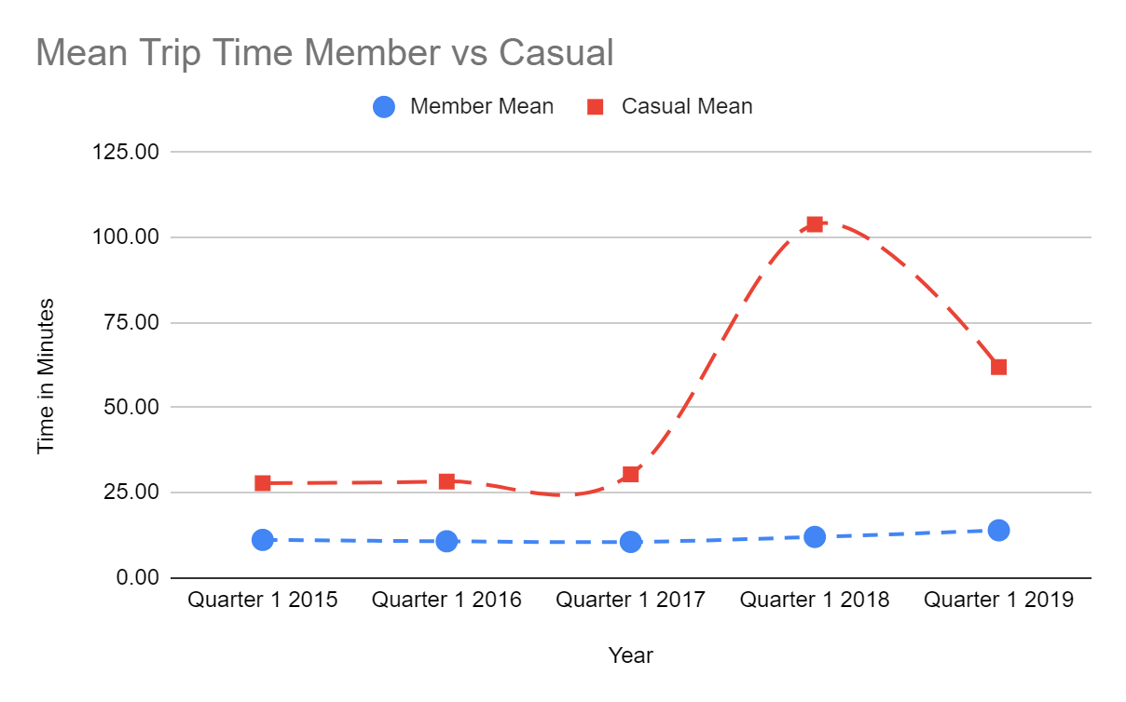
Notes:
This is the true average. Take all of the trip ride times and add them up then divide by the total number of trips.

Slide 6
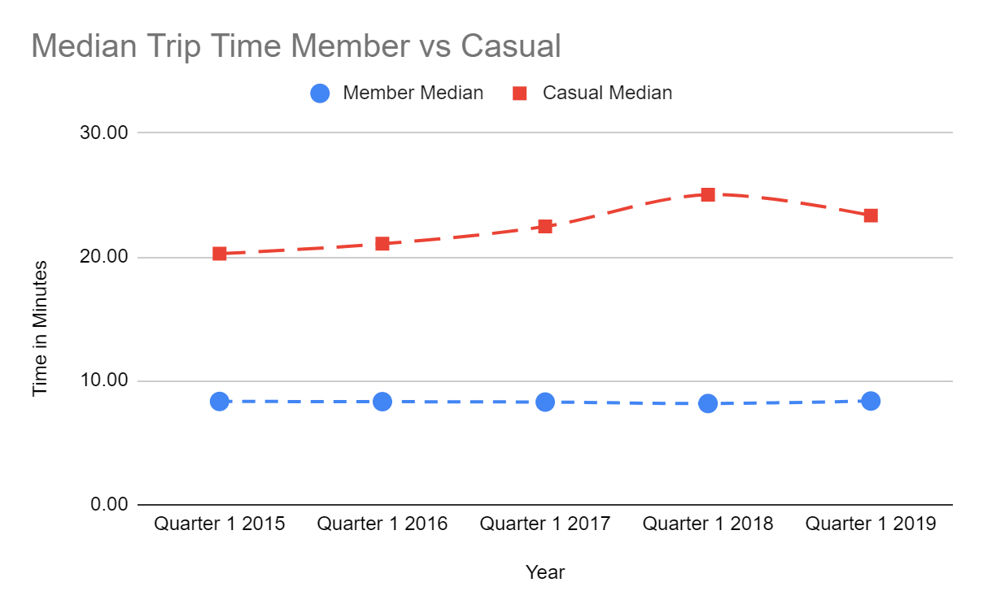
Notes:
The Median is the middle number if every trip is in order.

Slide 7
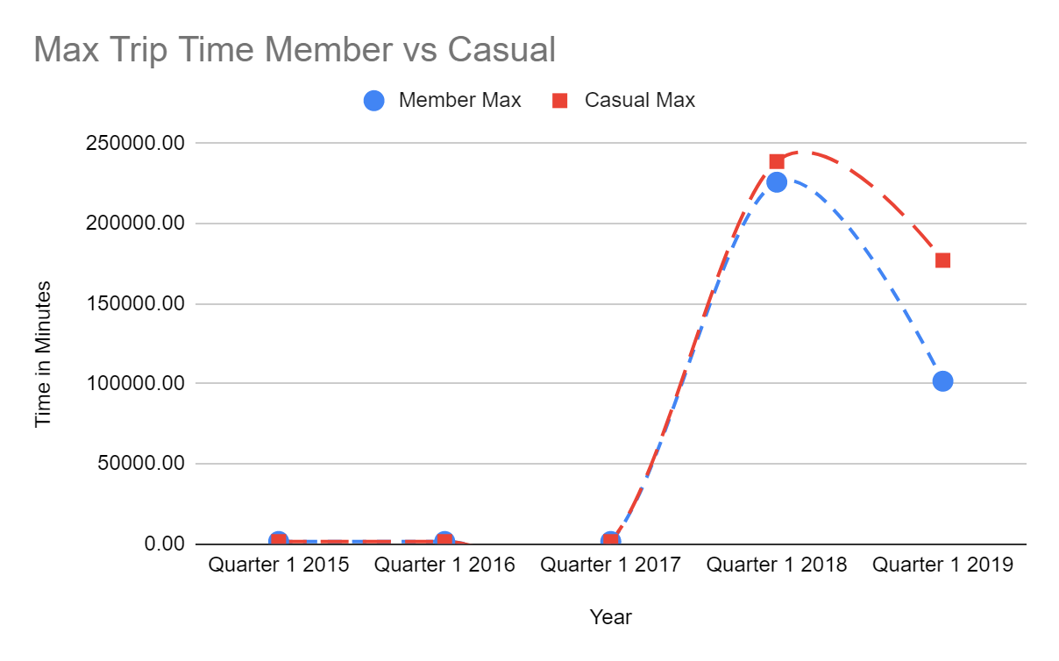

Slide 8
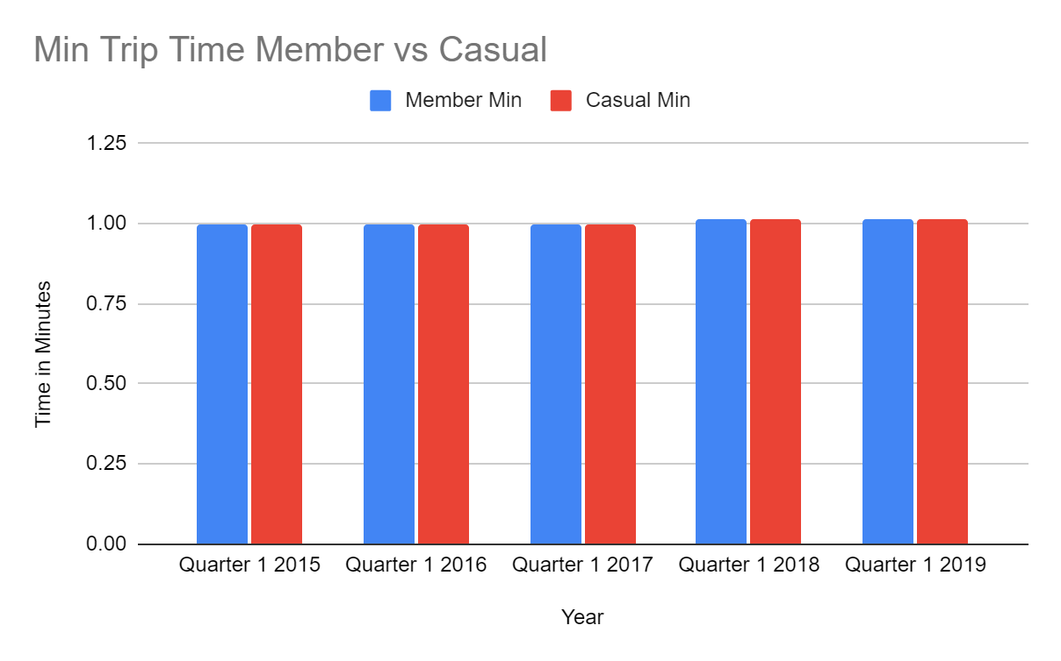

Slide 9
The usage of each bike type
Notes:
This is going to show us what bikes are being used and by whom. This will show us how much each type of bike is used. This will allow us to understand what types of bikes we need to get more of and or what parts are going to be needed.

Slide 10
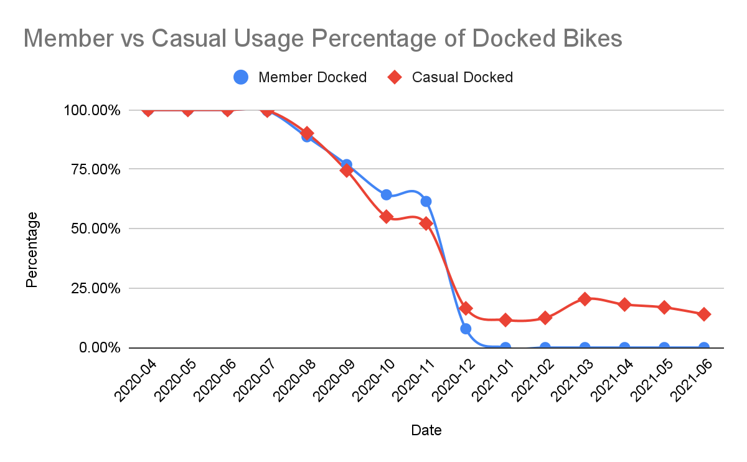
Notes:
What this is showing us is that out of all of the trips taken for both members and casual users what percentage of the trips was the docked bike used.
Things to note
This was the only bike from April 2020 - July 2020
Once the Electric bike was introduced in Aug 2020 the docked bikes dropped to be just over half of the used biks for members and a little bit more for casual users.
In Dec 2020 the Classic bike came out and we can see a massive drop in docked bike usage that ends with less then 25% in 21 for casual users and at 0% for members.
This would suggest that Members prefer the classic or electric bikes were the casual users will use what they can but do not prefer the docked bikes.

Slide 11
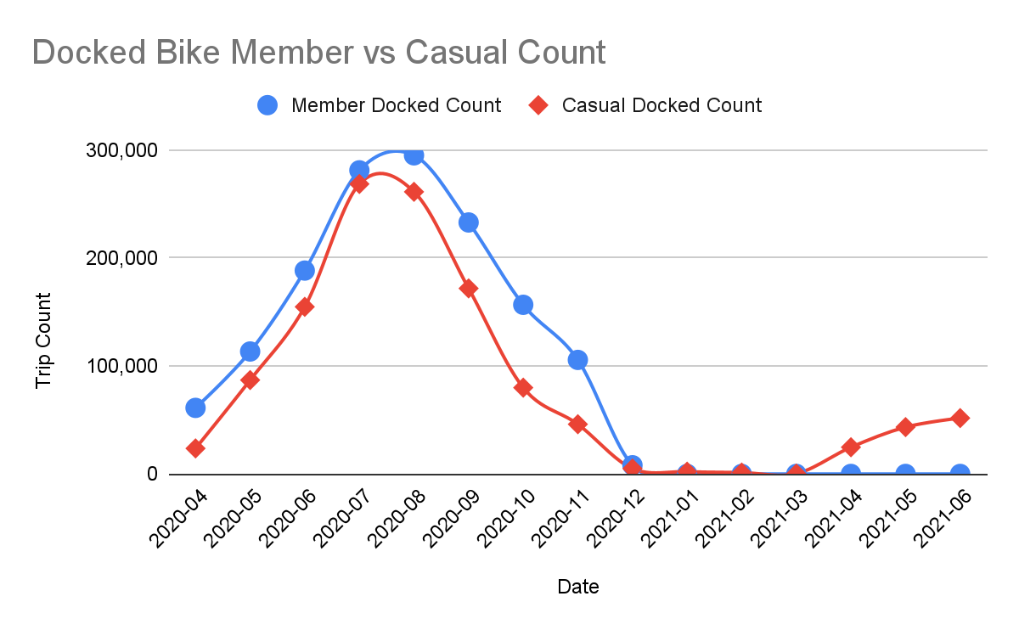
Notes:
This is showing us the trip count for docked bikes.

Slide 12
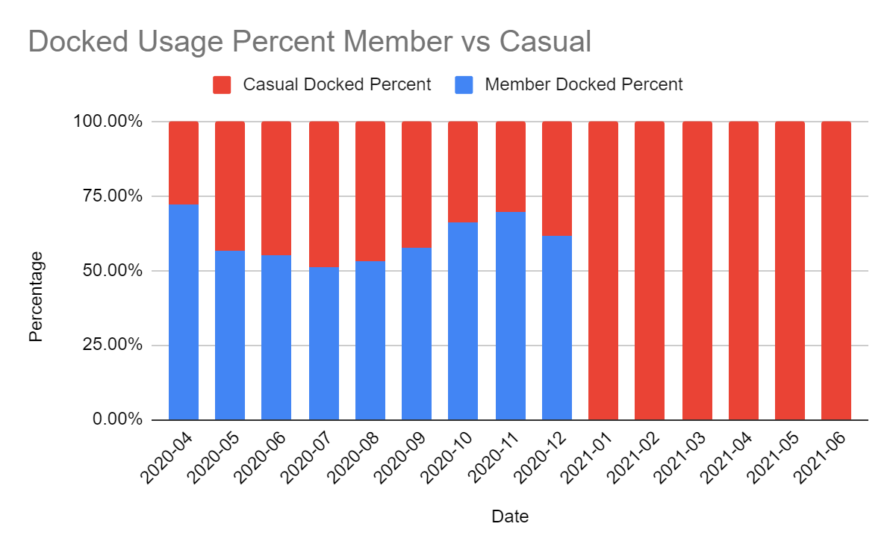
Docked Bike
Casual users got close to 50% in the summer months
Members consistently used over 50% until 2021 when they dropped to 0%
Notes:
What this is showing us is if there was 100 docked bikes what percentage of them would be used by members or casual riders. As we can see in 2021 only casual riders

Slide 13
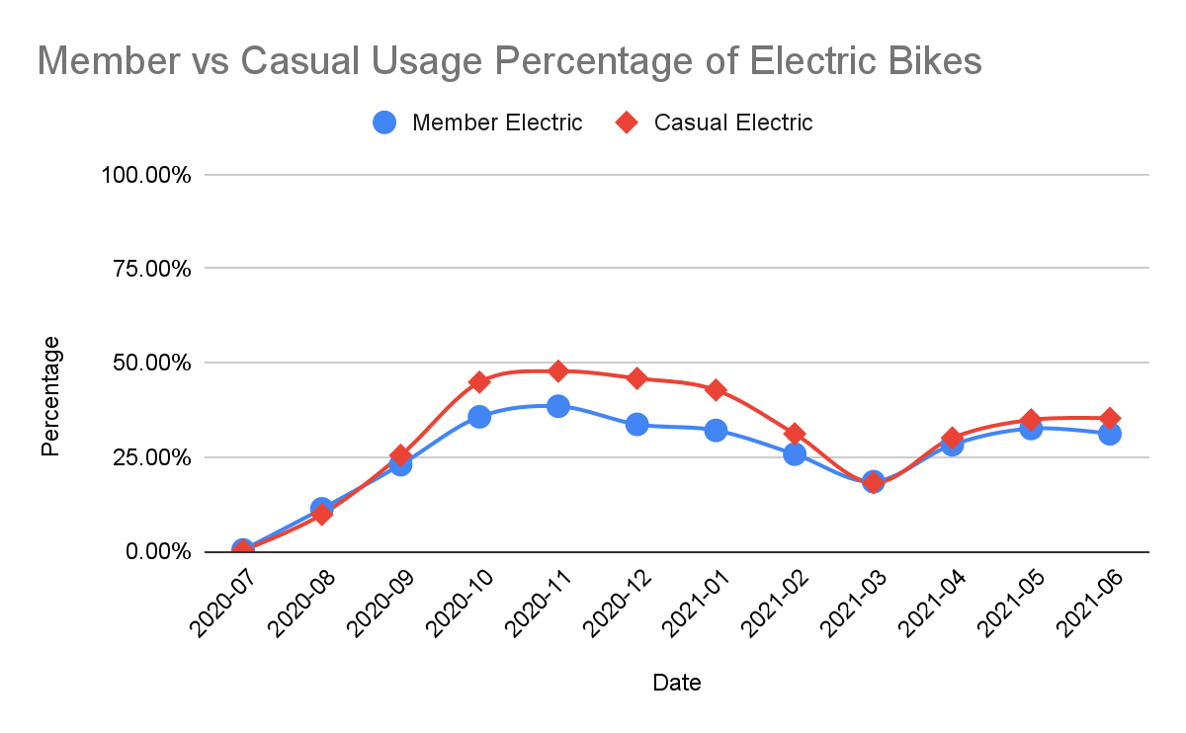

Slide 14
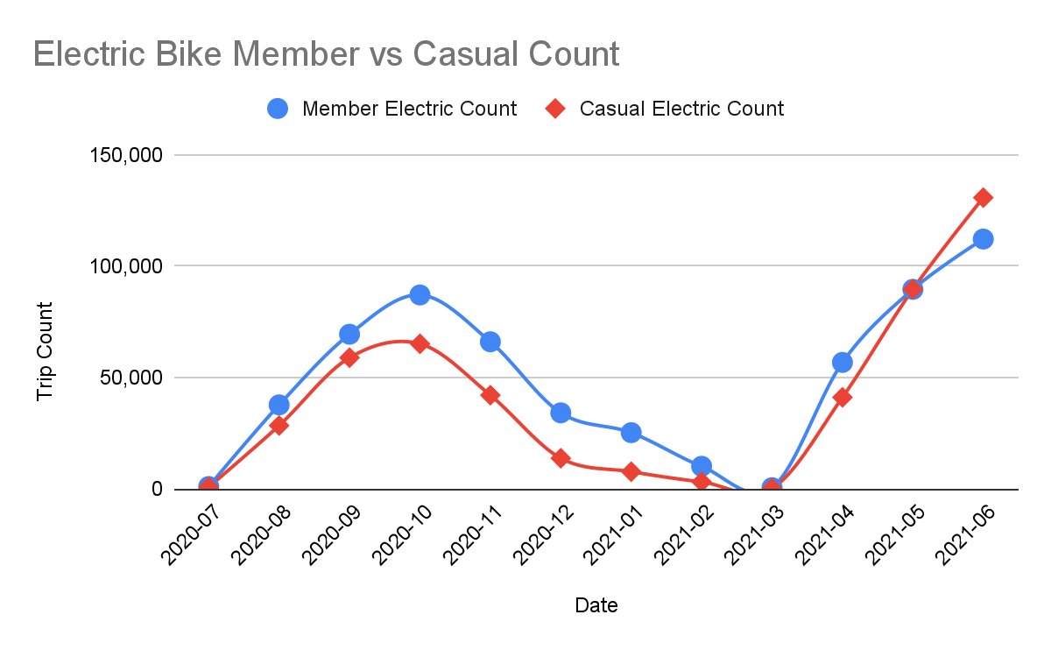

Slide 15
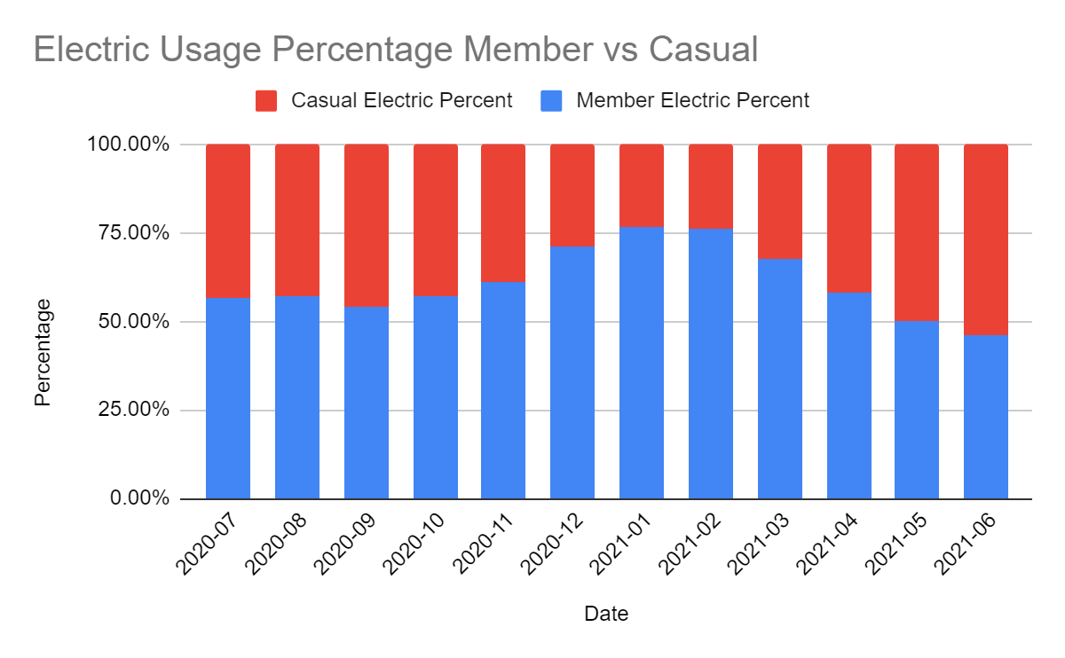
Electric Bike
The electric bike was introduced in July of 2020

Slide 16
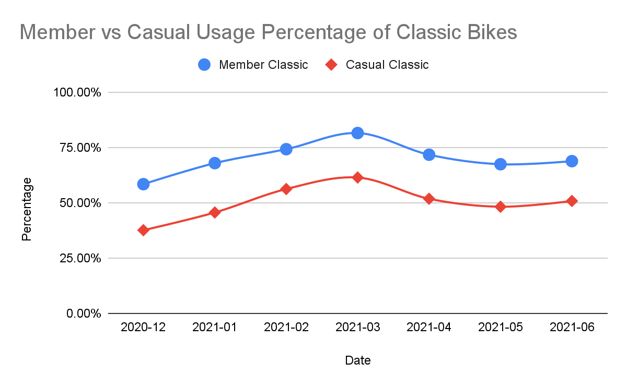
Notes:
When the classic bike launched members immediately flocked to it. The fact that in the first month we are above 50% for members and have not gone below 50% in all of the time that it has been an option says alot. Even in March when as we have seen belore with the other bikes and how few total trips taken the preferred bike was the classic for both members and casual users.

Slide 17
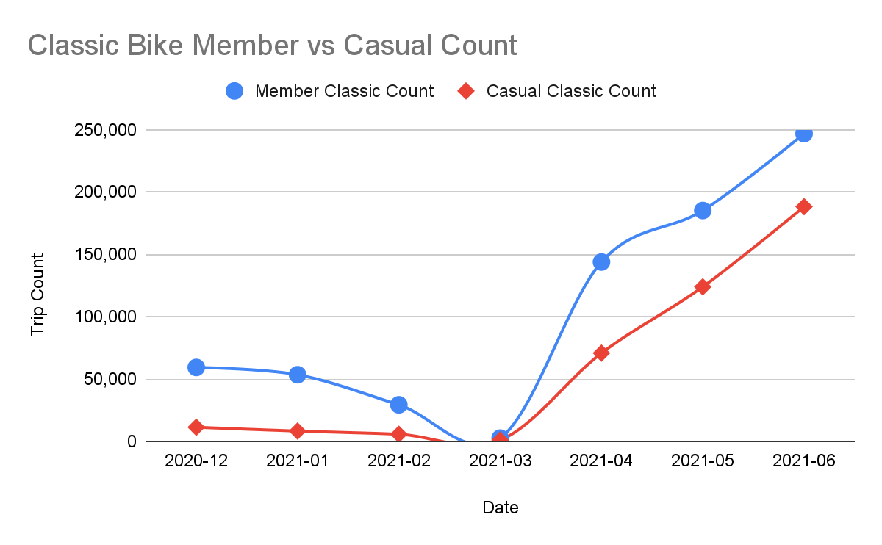
Notes:
The big thing to note here is just how many rides are being taken. We saw in the last slide how especially for members just how consistently popular this bike is. The jump from March to April from just about 0 trips to almost 150,000 and about 70,000 for members and casual users is amazing. It is aslo good to note that May and June have also seen an increase in total rides and it is very easy to predict that this trend will only continue into the peek summer months.

Slide 18
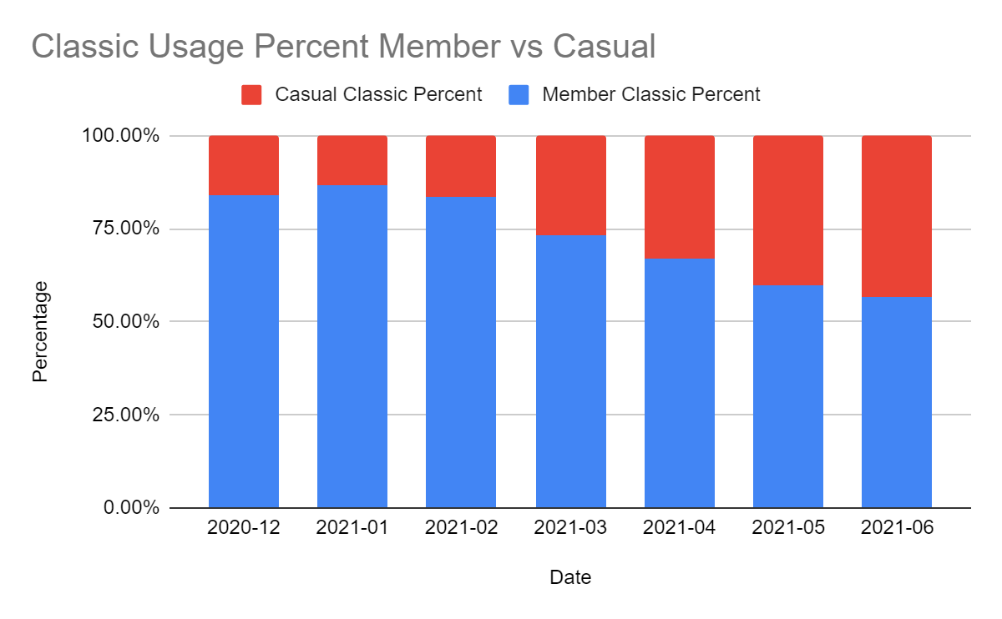
Classic Bike
The classic bike was introduced in December of 2020
Since the introduction this has been the preferred bike for members

Slide 19
Overall usage

Slide 20
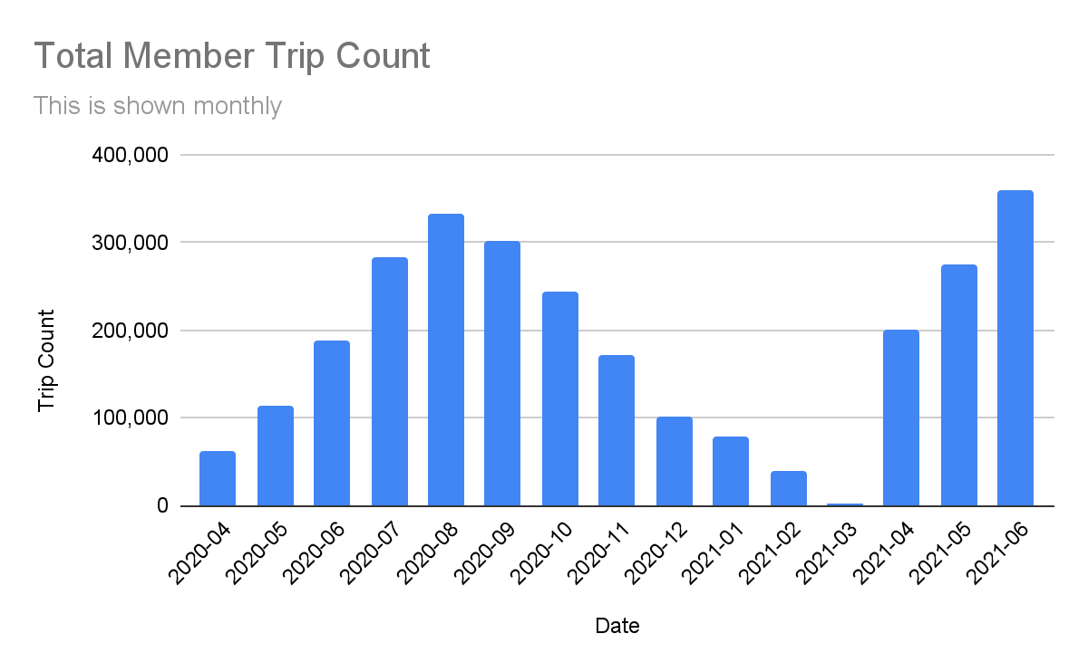

Slide 21
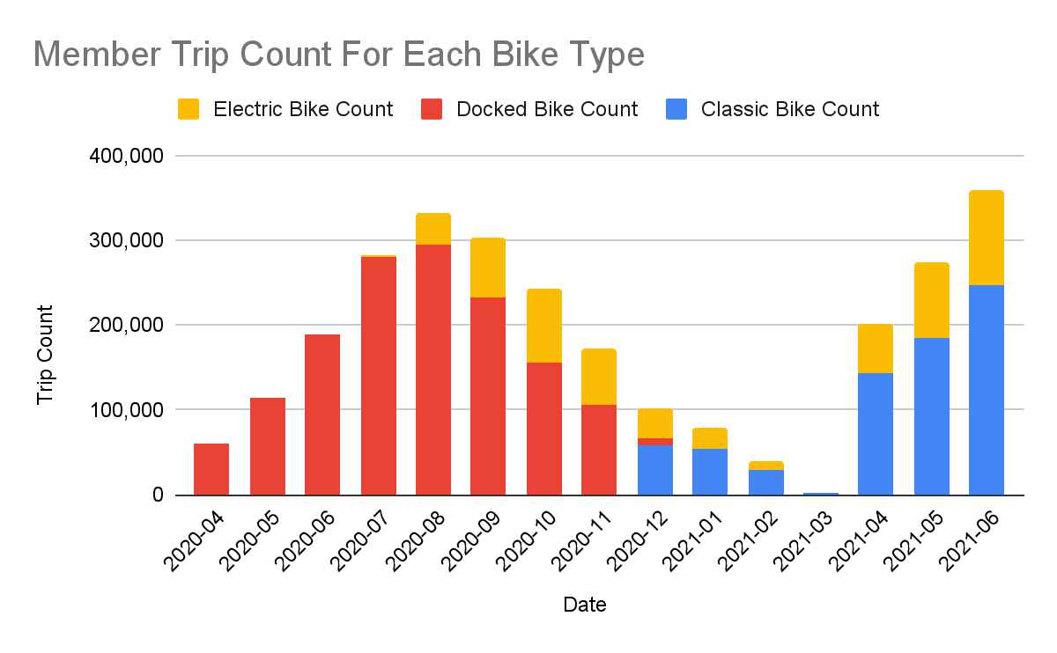
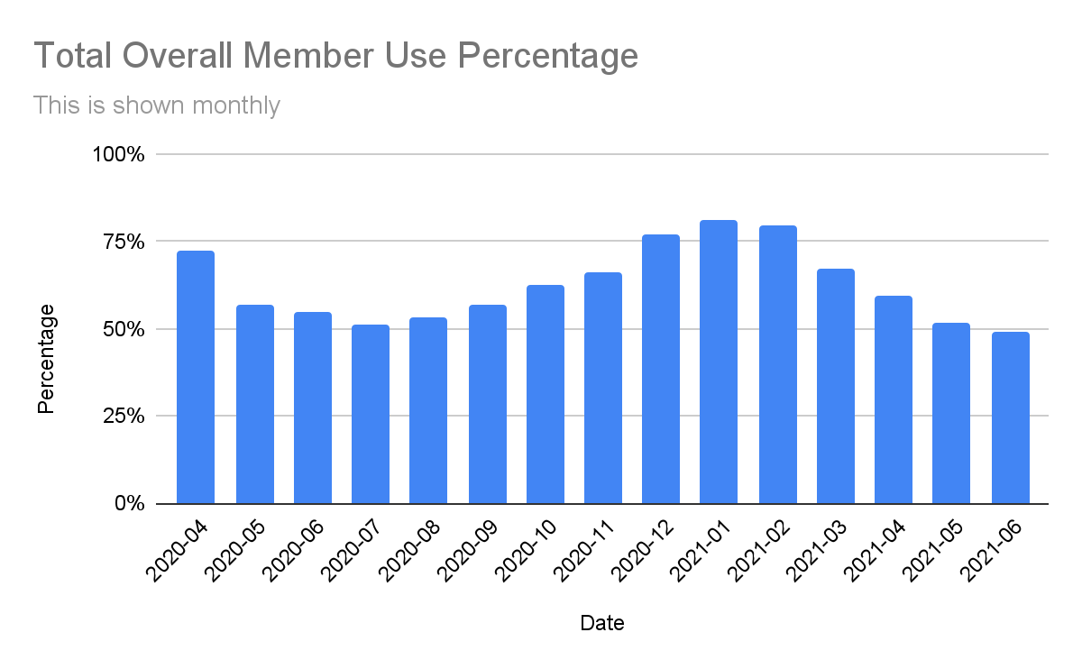
Members Usage
The classic bike is the preferred bike after its introduction
We can see how consistently members make up our percentage of trips
Notes:
This is showing the total number of rides for the members for each month for 14 months. This is also showing us what type of bike they are using.

Slide 23
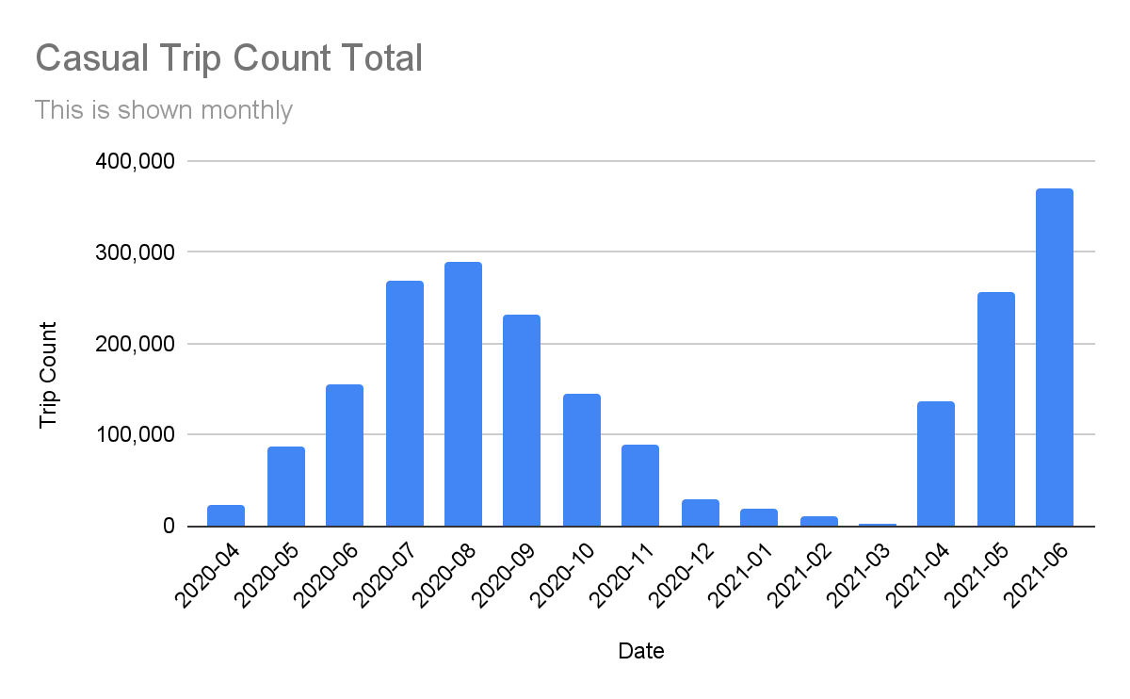

Slide 24
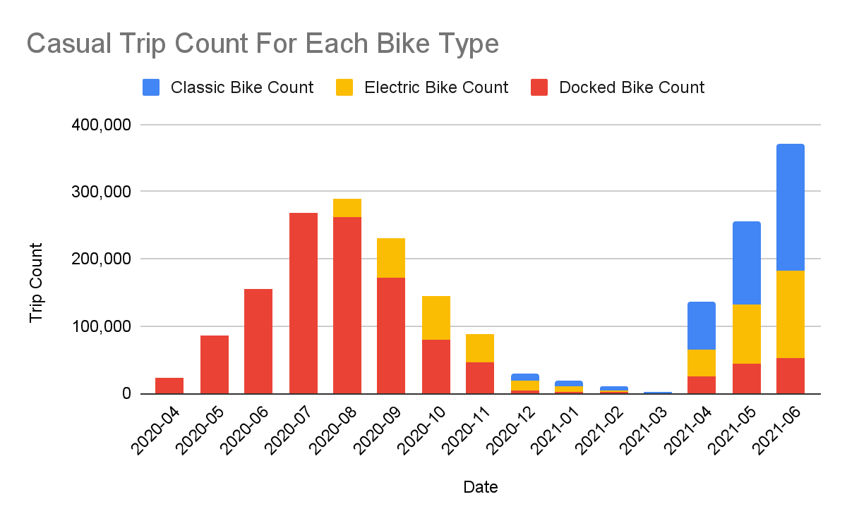
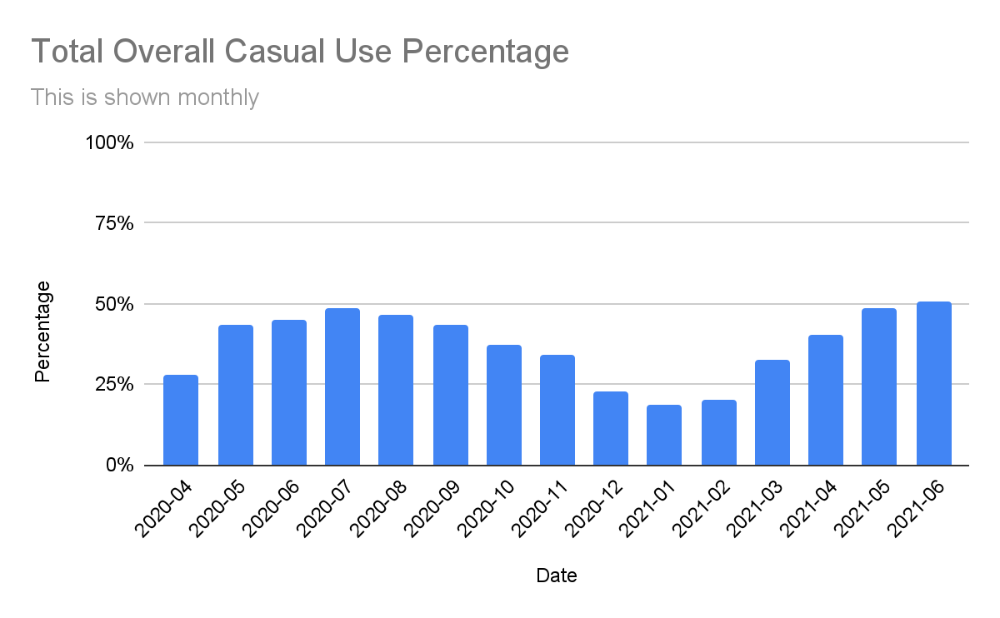
Casual Usage
We can see that Casual users will ride on anything but prefer the Classic bike
Casual users are very seasonal in their percentage of trips

Slide 26
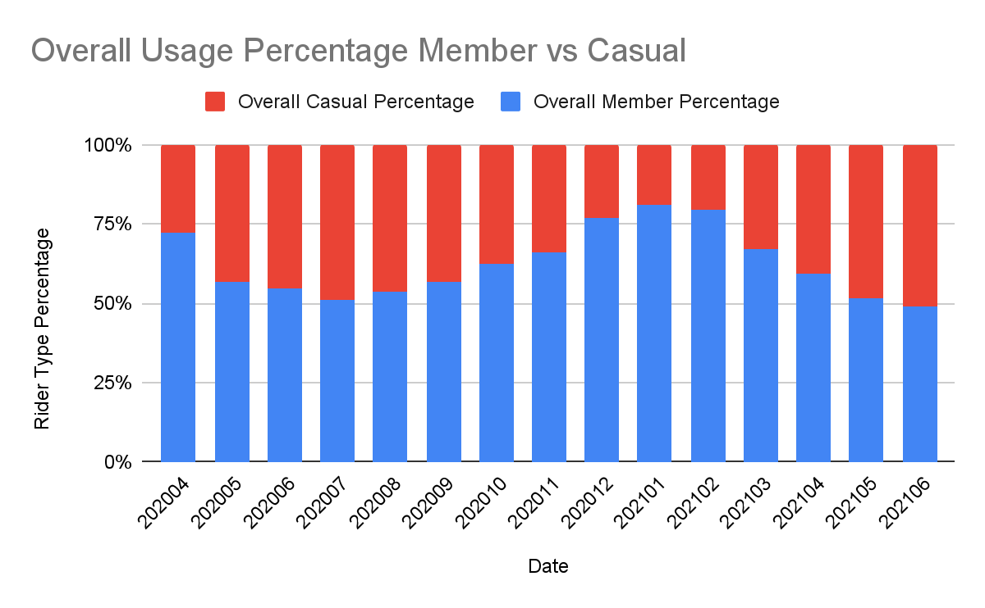
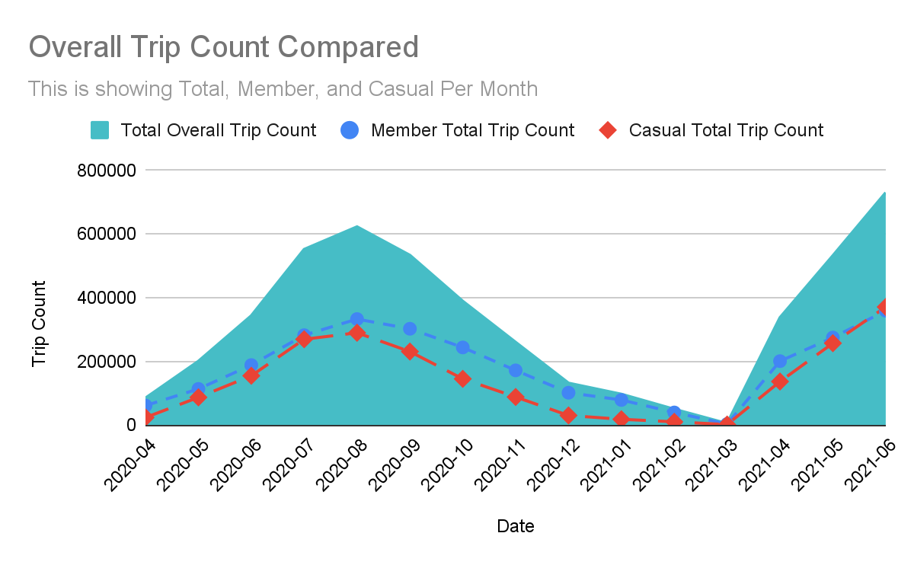
Compared usage
We can see that members have consistently used our service more
Look at how many more trips have been taken in 21 compared to 20

Slide 28
Findings
Members
Use the service more consistently year round
Prefer the Classic bike
Casual
Will use whatever bike they can but prefer the Classic
Are using the service more in 21 than in 20

Slide 29
Predictions
Casual users will make up the majority of the total rides for July 21 ~ September 21.
The Classic bike will continue to be the favorited bike type for both users
In the peek of 2021 we will see close to 1 million rides in a single month

Slide 30
Recommendations
Replacing the docked bikes with more classic bikes.
When advertising for new membership it will work best for us to do so during the late spring - early fall months when the casual riders use our service the most.
I would recommend that we should look into a seasonal membership for the summer season.

